Slide 1
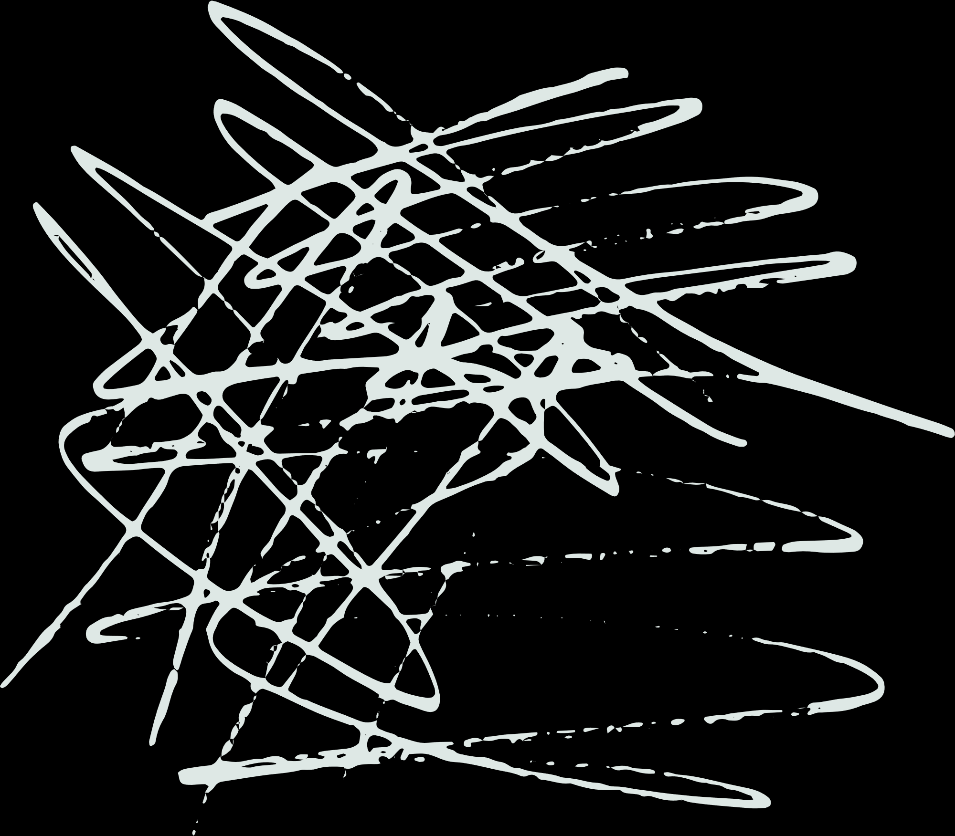






2-APPROXIMATION ALGORITHM FOR THE
MINIMUM WEIGHTED STEINER TREE PROBLEM
PRESENTED BY:
J Bhavishya: 21CSB0A24
Tanu Priya: 21CSB0A58
Madhumitha Thota: 21CSB0A61

Slide 2

CONTENTS
01.
Problem Statement
02.
Class of Hardness
03.
Proposed Solution
04.
Results obtained by our implementation
05.
Limitation of proposed method
06.
Improvements

Slide 3

PROBLEM STATEMENT
The Steiner tree problem in graphs can be seen as a generalization of two other famous combinatorial optimization problems: the shortest path problem and the minimum spanning tree problem.
Given an undirected weighted graph G=(V, E), where V is the set of vertices and E is the set of edges. Each edge e in E has a non-negative weight w(e). Additionally, also there is a subset T⊆V of terminals.
Our task is to approximate the weight of the Steiner Tree, which is a minimum-weight connected subgraph of G that spans all terminals in T.

Slide 4
CLASS OF HARDNESS
Given an instance of the Hamiltonian Cycle Problem (a graph), we need to construct an instance of the MWSTP.
For each vertex in the graph, create a corresponding terminal in the MWSTP instance.
For each edge in the graph, assign it a weight of 1 in the MWSTP instance.
For each pair of terminals not directly connected by an edge in the original graph, add a Steiner point and connect it to both terminals with an edge weighted by 2 in the MWSTP instance. This transformation can be done in polynomial time.

Slide 5
CLASS OF HARDNESS
If the original graph has a Hamiltonian cycle, then the corresponding MWSTP instance will have a Steiner tree with weight equal to the number of vertices minus 1.
Since the Hamiltonian Cycle Problem is NP-complete and we have shown a polynomial-time reduction from it to the MWSTP, the MWSTP is also NP-Hard.

Slide 6
PREVIOUS SOLUTION
Input: G = (V, E, w), Y⊆ V;
Output: A minimum total edge cost of a subtree
T = (V′, E′), Y∈ V′;
Compute P_{VW} for all w, v ∈ V;
for (i = 2,...,k −1) do
For any |X| = i and any w ∈ Y, v ∈ V:
T(X ∪ Y)=min{P_{VW} ∪ T(X′ ∪ w) ∪ T(X′′ ∪ w)}
end

Slide 7
PROPOSED SOLUTION
Input: G =(V, E, w), Y ∈ V;
Output: a minimum total edge cost of a subtree T = (V′,E′), Y ∈ V′;
Construct the metric closure G_{Y} on Y;
Find an MST T_{Y} on G_{Y};
Set T ←∅;
for each edge e = (u, v) ⊂ E(T_{Y}) do
Find a shortest path P from u to v on G
if P contains less than two vertices in T then
Add P to T
end
else
Let p_{i} and p_{j} be the first and last vertices already in T
Add subpaths from u to p_{i} and from p_{j} to v
end
end

Slide 8
APPROXIMATION
Approximation algorithms are used in the Steiner Tree problem because exact algorithms often have prohibitive computational complexity.
The Steiner Tree problem is NP-hard, which means that solving it exactly (finding the optimal solution) can be extremely time-consuming, especially as the number of terminals and potential Steiner points increases.

Slide 9
APPROXIMATION
In practical scenarios, the problem size can become so large that finding an exact solution becomes computationally infeasible.
Approximation algorithms provide a trade-off between solution quality and computational efficiency. They aim to find solutions that are close to optimal within a reasonable amount of time.
While these solutions may not be guaranteed to be the best possible, they are often acceptable for practical purposes.

Slide 10
2- APPROXIMATION ALGORITHM
Step 1: Compute the Metric Closure.
Create a complete graph (G' = (V, E')) where the weight of an edge ((u, v)) in (G') is the shortest path distance between (u) and (v) in (G). This can be done using Dijkstra algorithm.
Step 2: Compute Minimum Spanning Tree (MST).
Use Prim’s algorithm to find a minimum spanning tree (T') of the graph (G’).
Step 3: Transform the tree.
Transform (T') back into a tree (T) in the original graph (G) by replacing each edge ((u, v)) in (T') with the corresponding shortest path between (u) and (v) in (G).
Step 4: Output The resulting tree (T) is a 2-approximation of the MWSTP.

Slide 11
By constructing the metric closure in step 1, we essentially replace each edge with the shortest path distance between its endpoints. This ensures that the resulting graph is metric, meaning it satisfies the triangle inequality property.
Computing the minimum spanning tree (T') of the metric closure graph in step 2 ensures that we have a tree connecting all vertices with minimum total edge weight.
Transforming (T') back into the original graph (G) in step 3 preserves the metric property of the tree while ensuring that it only uses edges from the original graph.
The resulting tree (T) has a weight that is at most twice the weight of the optimal Steiner tree, making it a 2-approximation algorithm for the MWSTP. This is due to the fact that the shortest path distance between any two vertices in the metric closure is at most the corresponding distance in the original graph.

Slide 12
APPROXIMATION RATIO
We will evaluate the quality of the solution of this algorithm in theory.
Let G_{Y} = (Y, E(G_{Y}), w̅). Note that w(T) ≤ T_{Y}, since at most all of the shortest paths between each pair of terminals are inserted. We want to compare TY with an SMT.
Let T*_{Y} be the SMT. Consider a Eulerian tour X on the doubling tree. Since the tour passes each edge exactly twice, we have w(X) = 2(T*_{Y}).

Slide 13
On the other hand, since the tour visits all the terminals in the graph, we have
w(X) ≥ w(tsp(G_{Y})) ≥ w(T_{Y}),
w(T) ≤ w(T_{Y}) ≤ 2×w(T*_{Y})
To see that the upper bound is asymptotically tight, consider an extreme example. Suppose that there are k terminals, and 1 nonterminal.
The terminals form a cycle with w(e) = 2 for each edge e in the cycle. The nonterminal is adjacent to each terminal with an edge of length 1.

Slide 14
The SMT is the star centered at the nonterminal in the middle of the graph and has total cost k. Meanwhile, an MST is the path consisting of the terminals and has total cost 2(k − 1). Therefore, the Steiner ratio is
ρ = w(MST(G_{Y}))/w(SMT(G_{Y})) = 2(k−1)/k =2−2/k;
Hence, the approximation is a 2-approximation. The Steiner ratio in general metric is 2, and is smaller in the Euclidean metric as the Euclidean space is a restricted version of the general metric.

Slide 15
1
EXAMPLE
2
1
1
2
1
1
1
1
1
1
1
1
1
1
2
1
2
1
2
2
(a)
(b)
2
2
2
2
2
2
(c)
(a) A graph in which white vertex is non-terminal and others are terminals. (b) An SMT (c) An MST of subgraph induced on terminals

Slide 16
EXAMPLE
Suppose there are k terminals and 1 non-terminal.
The terminals form a cycle where each edge has weight 2.
The non-terminal is connected to each terminal via edges of length 1.
In this setup, the SMT is a star centered at the non-terminal, having a total cost of k.
On the other hand, the MST is a path connecting the terminals, with a total cost of 2(k−1).

Slide 17
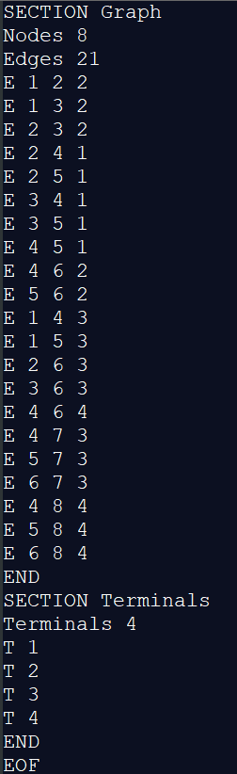
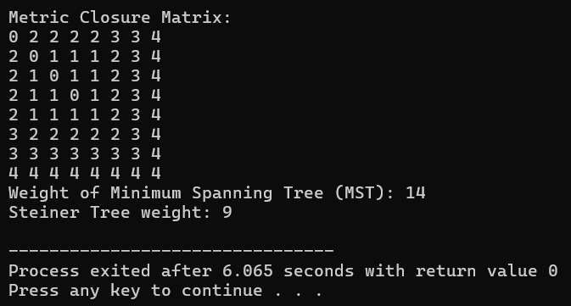
RESULTS(1)
Click here to see full code

Slide 18
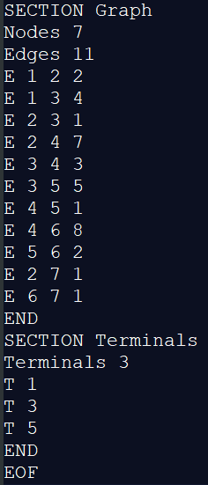
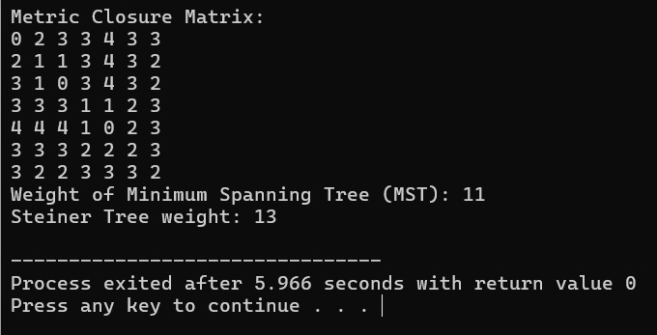
RESULTS(2)
Click here to see full code

Slide 19
LIMITATIONS
1) Not Always Twice the Best: The algorithm promises to find a Steiner Tree with a weight that's at most double the weight of the best possible tree connecting the given points. But in some cases, the actual weight might be much higher than twice the best.
2) Assumption of Triangle Inequality: The algorithm assumes that the edge costs in the graph follow the triangle inequality. However, this assumption is not always guaranteed in real-world scenarios. If the triangle inequality doesn't hold, it can lead to incorrect solutions, raising concerns about the algorithm's correctness for generalized graphs.

Slide 20
LIMITATIONS
3) Not Always Close to Best: Even though it's supposed to be close to the best solution, the tree it finds might not always be very close to the best one. It can sometimes be quite far from the best possible tree.
4) Can Be Slow: Especially when dealing with big graphs or lots of points, this algorithm can take a long time to run. This makes it not very practical for certain situations because it's too slow.

Slide 21
IMPROVEMENTS
Relaxation of Assumptions: Relax the assumption of the triangle inequality and develop algorithms that can handle graphs where this property does not hold. This could involve adapting existing algorithms or developing new ones tailored to such scenarios.
Nearest Neighbor Heuristic: This heuristic starts from a terminal and iteratively adds the closest un-connected terminal until all terminals are connected.
Prim's Algorithm Variant: This approach modifies Prim's minimum spanning tree algorithm to allow adding non-terminal Steiner points during the tree construction.
Reduction to Traveling Salesman Problem (TSP): In some cases, the Steiner tree problem can be reduced to a TSP instance. Efficient TSP heuristics can then be applied to get approximate solutions for the Steiner tree.

Slide 22



THANK YOU!

